Slide 1
Factory Method Design Pattern
By: Romerico David, Aimable Mugwaneza, Kehinde Osunniran

Slide 2
What is the Factory Method Design Pattern?
A creational design pattern.
Defines an interface for creating objects but lets subclasses decide which class to instantiate.

Slide 3
Key Properties of Factory Method
The client doesn't instantiate concrete classes directly
The factory method encapsulates the creation logic
New plan types can be added without modifying existing client code

Slide 4
Motivation for Factory Method
Imagine you’re building a logistics application that handles different types of transport, like trucks and ships. You want the application to create these transport objects without needing to know the exact type in advance. The Factory Method pattern helps by allowing you to define a general method in a base class that lets subclasses decide which specific type of transport to create. This way, your code can request a transport object without worrying about whether it’s a truck, ship, or any other type.

Slide 5
Electricity Billing System Example
Calculate the bill for different types of customers.
Types of Plans:
Domestic Plan
Commercial Plan
Institutional Plan

Slide 6
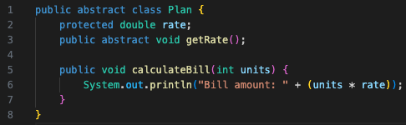
Plan is the interface that defines the operations that all objects the factory method creates must implement

Slide 7



These are the actual classes that define the behavior for each type of product the factory can create

Slide 8
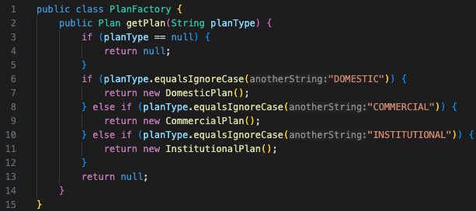
This is the class that defines and implement the factory method which returns an object of type Plan

Slide 9
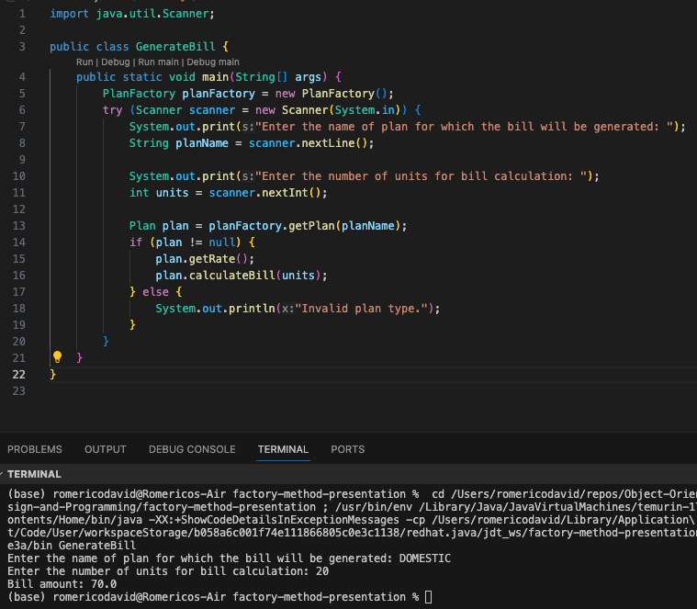

Slide 10
Advantages vs Disadvantages
Advantages
Disadvantages
Loose Coupling: Clients are decoupled from concrete classes.
Open/Closed Principle: Easy to introduce new plan types.
Reusability: Common creation logic is centralized reducing duplication
Complexity: Increases the number of classes.
Subclassing: Requires subclassing to change the product's class.

Slide 11
References
https://www.geeksforgeeks.org/factory-method-for-designing-pattern/
https://en.wikipedia.org/wiki/Factory_method_pattern
https://sourcemaking.com/design_patterns/factory_method

